Slide 1
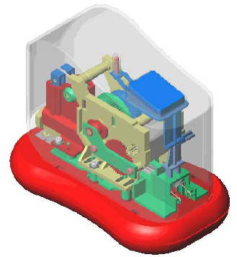
Oral English Technical
Mini project self-contained stapler
Perez Romain
1STI2D

Slide 2
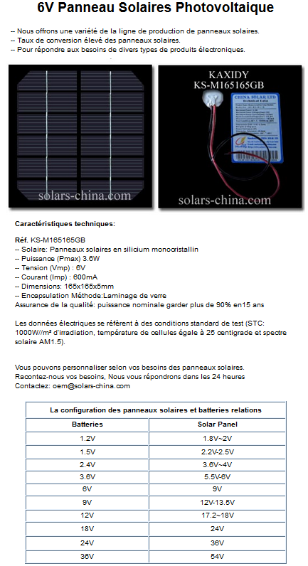
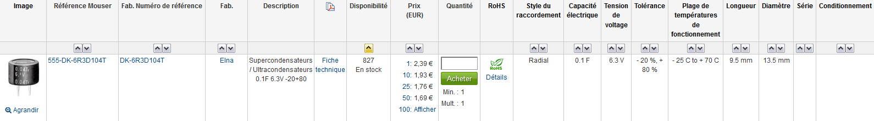
Tasks: Seaches performed
Compact solar cell
Supercapacitor

Slide 3
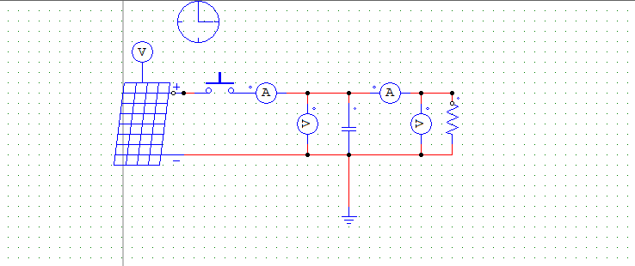
Tasks: Program PSIM

Slide 4



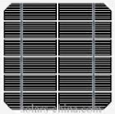







Tasks: Chains
Information chains
1
ACQUIRE PROCESS
2
STOKE STORE DISTRIBUTE CONVERT TRANSMIT PROCEED
Energy chains
1:-Bundle sensor
-End sensor
-Blocking switch
2:-Reducer
-Slide lever

Slide 5
Conclusion
Thank you for watching

